Slide 1
The EVOLVING ROLE OF THE IMF
AND IMPLICATIONS FOR EVALUATION
NICOLETTA BATINI and PRAKASH LOUNGANI
IEO@20 Virtual Conference | November 16, 2021
Notes:
Thank you, Jim.
My presentation summarizes work by Prakash Loungani and myself on the evolution of the IMF’s role over time and how the IEO can help the Fund face new challenges as well as old ones.

Slide 2
The past two and a half decades
Inclusive Growth (“non-core”)
Macrofinancial Stabilization (“core”)
Other “non-core”
An evolving IMF
Two key developments that have shaped the IMF’s work
Financial crises were costly setbacks to income
Uneven growth in income—slow catch-up in LIDCs
So, increase in Fund macro-financial work but also new avenues like support for inclusive growth
Notes:
Two key developments have shaped the IMF’s work over the past 25 years.
First, the IMF has had to manage recurrent financial crises, particularly in emerging markets over the 1994-2002 period and then in advanced economies during the Global Financial Crisis (GFC) of 2008-09. These crises have not dented the long-term upward course of global income but they have had large short-term costs and, for individual countries, have sometimes implied a ‘lost decade’ of incomes—Argentina and Greece are two prominent examples.
Second, while average incomes have been going up in most countries, they have done so by vastly different amounts across countries and within countries. Increasing recognition of such differences has led the IMF away from a rigid adherence to the old orthodoxy toward a broader set of policies that would foster greater macro-financial stability and more inclusive growth.
As a result, over the past 25 years there has been both an increase in the demand for the IMF’s core work of fostering macro-financial stability and managing recurrent crises as well as more attention toward policies for inclusive growth, which has taken the IMF into areas that some consider outside its core mandate. In the paper we discuss these developments and how IEO evaluations have helped the IMF adapt its policies on these two fronts.

Slide 3
The next decade: main events?
Started with a bang (COVID-19). Hard to predict what will hit the global economy—possibly more “super-crises”.
Distinction between “core” and “non-core” will become increasingly blurred….
…because it is likely that work on climate change will expand considerably given economic impact of planetary challenges, and with it work on inclusive growth
A bigger, more eclectic, less self-reliant IMF, better suited to serve well all country groups
Notes:
Looking ahead, as we think about how the IEO can help the IMF meet the challenges of the next decade, it is useful to reflect on how the IMF’s own role will continue to evolve.
It is hard to forecast what events will mark the next decade. For sure the decade started with a bang—the COVID-19 pandemic. But in fact, each decade of the IMF’s existence has been marked both by known challenges and new ones that were difficult to anticipate.
It seems quite likely that—like the current pandemic—some of the crises that the Fund will have to manage in the future will be amalgams of environmental (or health) and financial crises, with implications for the Fund’s toolkit and policy advice. We call these “super-crises” by virtue of their multi-shock, global scale, long-legacy connotations.
We also expect that the distinction between the Fund’s “core” and “non-core” work will become increasingly blurred. We think that work on climate change will expand considerably given the growing economic impact of increasing planet-wide challenges. Indeed, work on climate issues could potentially dominate Fund work, given the wide-ranging economic implications of energy and food systems transitions necessary to stabilize the Earth system during this decade and beyond. Likewise, we expect work on inclusive growth to be scaled up and become more deeply entrenched in IMF policy advice and lending activity. This trend will be reinforced because both the pandemic and climate change have a strong regressive impact on low income and vulnerable countries, as well as for low-income sections of the population within countries.
Indeed, LIDCs are the countries that most need the IMF’s help to achieve sustained and inclusive growth—but where the IMF was able to provide the least financial support at least in GDP terms during the pandemic. Looking ahead, these are the countries most likely to be adversely impacted by climate change and least able to cope. And the growing outlet of mass migration has enormous spillovers on the advanced economies, notably through the anti-immigrant backlash and the rise of populism.
Reflecting these trends, the Fund will need to expand its resources dedicated to its non-core areas outside its core expertise in macroeconomic policies. It will also need to become less self-reliant and more committed to working closely with partners with much greater depth and expertise in areas such as climate and inequality.

Slide 4
This decade: the future role of the IEO?
Topics and Themes
Attention to:
Instruments and Resources
Shorter/sharper evaluations
New, non-core topics
Fund mandate
Fund collaboration with partners & eval. offices
Fund staff skills & budgetary resources
Buttress IEO role as key channel for Fund/CSO interaction
More virtual outreach
Build own skill set
Notes:
We think that the IEO can play a key role in helping the Fund strengthen its capacity to manage oncoming challenges, but the IEO must also be ready to adapt and innovate.
In particular, we suggest a number of possible shifts in the IEO’s strategy and focus, both on topics for evaluation and the instruments and resources we use.
On topics for evaluation, clearly, the IEO will have to evaluate more frequently and more systematically the Fund’s work in emergent non-core macro-critical areas, notably in the areas of climate change and inclusive growth. So far, these areas of Fund operations have received less attention from the IEO, in part because—while these topics are by no means new—their coverage by the Fund is relatively new. But this will change as the IMF increasingly steers its operations, as we expect, more in this direction. The IEO may also usefully consider the broader questions related to the Fund’s institutional mandate, including by evaluating the way the Fund balances attention to core and non-core activities.
Second, the IEO may have to invest more in evaluating the Fund’s collaboration with other international partners. One challenge will be to consider how best the IEO itself can work with evaluation counterparts. We have learned from experience with the recent evaluation of collaboration with the World Bank on climate and other issues how important it is for the IEO to work well with other evaluation offices. There is also the challenge of how to impact the Fund’s corporate culture. How best to encourage a shift away from the Fund’s “culture of self-reliance” and ensure the Fund invests more in working with other agencies that have comparative advantage as emphasis falls on Fund non-core areas.
Third, the IEO could get more involved in assessing the Fund’s human resource and budgetary strategy. Staff skills’ mix and resources will need to adapt to ensure that policy advice delivers true value added to member countries—advice that is in line with countries needs and expertise. For example, more granular advice in new areas will mean greater need for specialist skills, less “jack-of-all-trades” macro-economists. Also, the IEO could evaluate the issue of whether the Fund’s corporate model is well adapted to responding efficiently to “super-crises” and play a greater role in evaluating how the Fund manages enterprise risk.
In pursuing this broader agenda, the IEO interaction with civil society can become increasingly important in helping the IEO help the Fund. There is often a wedge between civil society’s concerns about inclusive growth and climate change and the Fund’s perception of its role and success in addressing such concerns, a wedge which could lead to growing challenges to the IMF’s legitimacy. The IEO can help reduce this wedge, through a closer collaboration with CSOs, both listening to concerns and helping assess how the Fund responds to such concerns. For example, the IEO can help ensure that the Fund’s work on climate change and inclusive growth is both transparent and committed.
On instruments and resources, we foresee the need for a greater use of shorter/sharper evaluations to better align timing of recommendations with fast-paced changes in Fund work. This is an issue my colleague Miguel will take up in a few minutes. We also see the opportunity to build on the experience from the pandemic, to make a greater use of virtual outreach and social media to leverage the IEO’s own limited resources to increase awareness of our work. Importantly, the IEO itself may have to gear up its own resources, making sure that our in-house staff have the background and experience to assess the quality of Fund advice on non-core issues.

Slide 5
Some issues for discussion
Main question: how can the IEO be most relevant in a changing world?
Should the IEO focus more on non-core Fund work?
Should the IEO provide more assessments of Fund collaboration with partner agencies?
And work more closely with evaluation agencies and engage more—than it does—with civil society?
Can and should the IEO engage in evaluations on IMF corporate strategies?
How should the IEO take advantage of new opportunities for virtual outreach?
Notes:
Let me end with a few issues for discussion on which we would like to hear your views.
The main question I guess is: how can the IEO best help the IMF be most relevant for a changing world?
Some ideas I just mentioned include:
Have the IEO focus more on evaluating non-core Fund work
Have the IEO provide more assessments of Fund collaboration with partner agencies, working closely with other evaluation offices; and engage more than it does with civil society
Have the IEO evaluate the Fund HR and budgetary strategies, as these are central to the Fund’s success—we believe—in dealing with upcoming challenges
And finally, have the IEO take advantage of new opportunities for virtual outreach, including through a more systematic use of social media.
We recognize that each of these strategic directions has strengths and weaknesses for the IEO and it is important to identify these well and strike the right balance between new targets, existing targets and available resources.
Your views on all this would be greatly appreciated. Thank you!

Slide 6
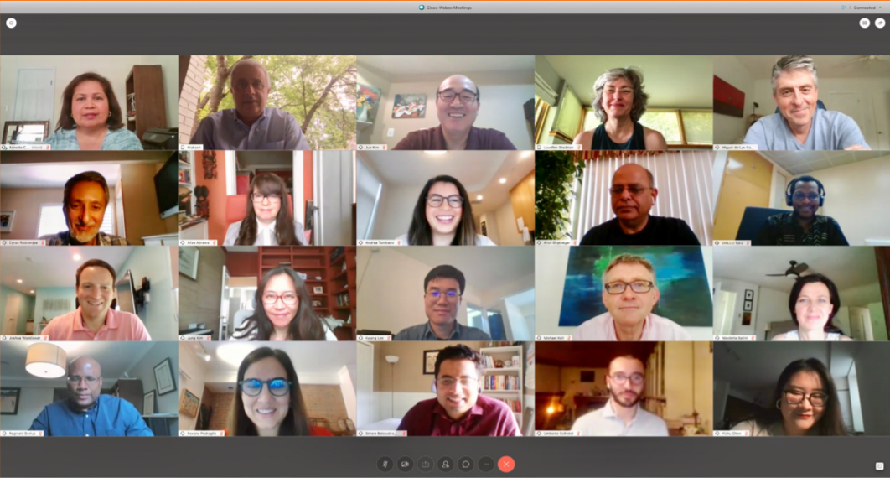
Thank you!
Visit us at www.ieo-imf.org

