Slide 1
The IEO’s Second Decade:
Some Reflections
Charles Collyns and Ruben Lamdany
IEO@20 Virtual Conference | November 16, 2021
Notes:
This presentation reflects on experience in the IEO’s second decade and seeks to set the stage for a discussion of lessons learned from the experience. Ruben is my co-author of a longer and more detailed chapter for a book now under preparation on the IEO’s second decade, but we have not tried to fully align our views in this presentation, and I am alone responsible for opinions expressed.
I will start with a brief primer on the IEO, then by lay out the key developments over the second decade, including steps to introduce new evaluation products, and strengthen the follow-up framework. I will also cover the role of external evaluations of the IEO, and the impact of the COVID-19 crisis.
I will then discuss two main challenges: first how to assess the IEO’s impact on the Fund, and how to increase it? Second how to set the IEO’s work agenda and in particular how much attention to pay to current issues of concern.
And I will end up by suggesting some issues for discussion.

Slide 2
Primer on the IEO
Established component of IMF governance since 2001
Supports Board oversight
Enhances institutional learning
Strengthens external credibility
Role is evaluation not audit or inspection
Independence is key
IEO is small but strategic
Catalyst for change, not research shop
Notes:
Most of you here already are well aware of the IEO, what we do and how we work. But it may be helpful at the beginning to give a short primer.
IEO was established 20 years ago in wake of Asia crisis—which also became a crisis for IMF credibility and legitimacy.
Our terms of reference give us three tasks:
-- first to support Board oversight by evaluating IMF performance in areas of concern..
-- second, the IEO helps the IMF as an institution to learn from experience, helping to overcome group think, break down silos and promote and champion new ways of thinking.
-- third the IEO helps to strengthen the IMF’s external credibility by increasing transparency about what the Fund does. Many of our reports are used by university professors who want to teach about how the Fund works.,
Its important to stress that an evaluation office is different from an inspector general or a compliance auditor—the IEO’s primary functions is not making sure the IMF is following its legal framework and internal rules but to provide an open-ended assessment of how well the IMF is accomplishing its mandate and how the IMF can be more effective in reaching its broad goals as defined in the IMF articles of agreement.
Key to achieving the IEO’s mandate is being independent of staff and management and having an arms-length relationship with the Board. This independence is well protected by our institutional structure provided in our terms of reference.
Its important to recognize that the IEO is small—we have around 15 full-time regular staff and are much smaller than counterparts at the WB and other MDBs. But we can have a large impact by being strategic in the issues that we evaluate.
Finally, I’d like to emphasize that we are not just about producing interesting reports to sit on a bookshelf but catalyzing institutional change. This depends on a robust follow-up mechanism and winning institutional buy-in to IEO findings and recommendations.

Slide 3
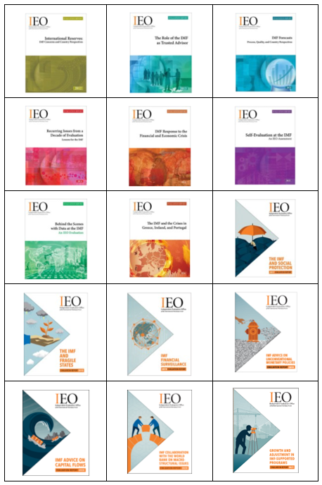
The IEO’s second decade: continuity and adaptation
Fifteen evaluations
Two new products: evaluation updates and shorter evaluations
Strengthened follow-up: SMART MIPs and more robust monitoring
Increased outreach and in-reach
Two external evaluations
Adaptation to the pandemic
Notes:
Looking back over the second decade the fundamentals of how the IEO works have remained broadly unchanged. The office has remained small, with capacity to complete around two products a year. Innovations have focused on adding tools to respond more nimbly to current concerns and reinforce the follow-up process to increase the value added and impact of the IEO’s work
Over the decade we have completed 15 evaluations covering all major areas of the Fund’s work, surveillance, lending and capacity development, and relevant to all groups of members, advanced countries, EMs and LICs. Evaluations have typically taken 18-24 months to prepare.
We have added two new products: evaluation updates were added in 2012 to come back to an issue after around ten years to assess progress made in addressing concerns and identify new challenges. And shorter evaluations were introduced in 2019 on a pilot basis to respond more nimbly by providing more timely input on new issues and concerns by focusing more narrowly. One shorter evaluation has been completed so far, completed in less than a year, although Board discussion was delayed by COVID-19.
Continued efforts have been made to strengthen the follow-up process. These include: requiring that follow up management implementation plans or MIPs be prepared by staff within six months of the Board discussion. And efforts by both IEO and staff to make sure that action items included in MIPs are SMART: specific measurable, attainable, relevant and timely. The Office of Internal Audit has been tasked with preparing the periodic monitoring report or PMR which reviews progress in implementing MIPs and discussion of the report has been elevated to full Board discussion, chaired by the MD, not just a Board committee. Moreover a triage process was introduced last year to address the growing backlog of action items that were off-track leading to a commitment to reformulate some key action items by the end of this year.
Efforts have also been made to increase impact by enhancing awareness of and learning from our work through greater outreach, both outside the Fund and inside the Fund. These efforts have been accelerated by increasing use of webinars to reach out to a wider audience, taking advantage of increased comfort with virtual meetings in the wake of the pandemic.

Slide 4
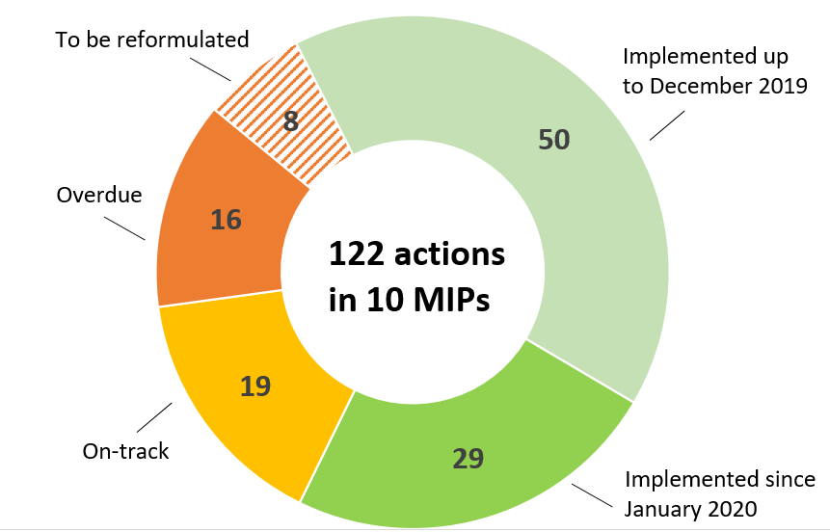
Implementation plan follow-up
Most recent PMR found:
Good record of implementation of recent plans
But still a number of overdue items, in part because of pandemic delays in work program
“Triage exercise” will reinforce approach in key areas
Sources: IMF, Eleventh Periodic Monitoring Report (2021).
Notes:
Let me now turn to consider the question of what has been the impact of all this evaluation activity on the IMF. There are many different levels at which such impact can be assessed. First, one can look at the record of implementation of the Board endorsed management implementation plans. Second, one can look at concrete changes in policies and practices more generally. And third one can consider the broader impact of evaluation on the Fund’s culture and governance structure, including the role of the Executive Board.
Turning first to the record with management implementation plans, this is assessed each year in the Periodic Monitoring report prepared by the office of Internal Audit.
The 11th PMR has just been completed—covering 122 actions in 10 MIPs completed over 2012-2020. It found good implementation of recent plans, which has been particularly impressive given the continuing work pressures from the pandemic. In all 79 actions were judged to be complete and 19 on track for completion. However, there were also 16 mainly older actions over due by one year, in part because of pandemic delays in the work program. Plus 8 actions are waiting to be reformulated under the terms of the triage exercise to deal with the backlog of incomplete actions that was conducted last year.
.

Slide 5
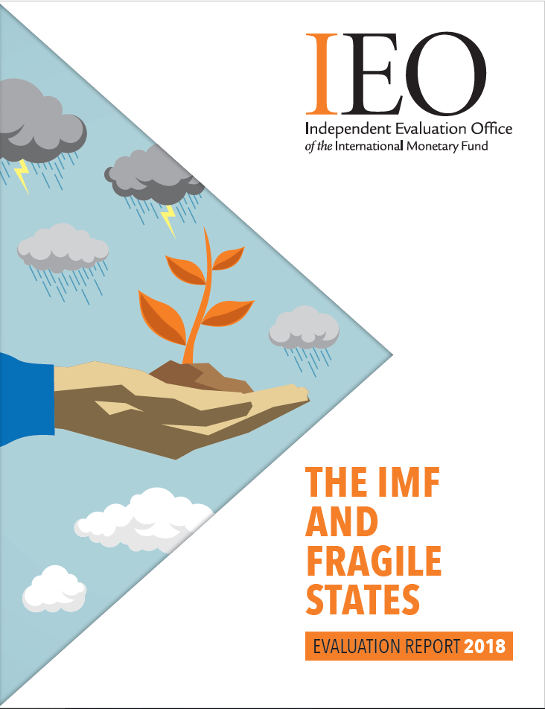
Impact on IMF policies and practices
Board approved policies:
Increased access limits under rapid financing
Strategy for Engagement in Social Spending
Strategy on Data and Statistics
Program Design in Currency Unions and collaboration with RFAs
Risk-based FSAP allocation
Reinforce capacity and best practices
Strengthened engagement with Fragile States
Deepen expertise on financial and monetary policy issues
Notes:
This slide goes beyond a numerical exercise of completion of action items to highlight some of the ways in which IEO evaluations have affected IMF policies and practices in recent years. This perspective focuses on changes that are important and impactful, although attribution to the IEO is less definitive since many factors go into the process of changing IMF policies and practices. I highlight the cover of the fragile states evaluation because I think it has been one of the most impactful at least in my time at the IEO. It demonstrated convincingly that IMF standard business model was not effective for what is recognized as a critical group of countries and offered practical solutions.
Recent changes in IMF policy frameworks where IEO evaluations have played a part include: increased limits approved in 2019 for rapid financing instruments to enhance Fund’s capacity to help fragile states; new framework on social spending approved two years after our evaluation of social protection, the new strategy on data and statistics, and new frameworks for program design in currency unions for collaboration with RFAs following the euro-area crisis evaluation, and a new risk based process for selecting countries for FSAP assessments following our financial surveillance evaluation..
In addition, evaluations can affect IMF capacity and practices more generally. For example, the report on fragile states led to reinforcement of efforts to increase impact of capacity development work and to incentivize staff working on these countries. Last year’s reports on FS and UMP led to hiring of new staff and experts in these areas at the core of the IMF’s work and increased research efforts in theses areas.

Slide 6
Recurring themes in IEO evaluations
Silo behavior – some progress
Evenhandedness – some progress
Attention to risks and uncertainties – some progress
Tailoring to country context – constrained progress
Depth of expertise – constrained progress
Working with partners – rising concern
Notes:
At a deeper level, evaluation can lead to changes in corporate culture that over time can address deep underlying issues rooted deeply in the institution. Such issues are hard to address with magic bullet solutions from a single evaluation but can be gradually influenced over the sweep of evaluations,.
The book at the end of the first decade identified a number of themes that have recurred across multiple evaluations. These themes have continued to be a focus in the second decade and new themes have emerged.
Some of these themes are common across large organizations that are highly effective in achieving their immediate goals but must continue to evolve to meet new challenges.
Others are more particular to large international organizations with governance structure seeking to reflect and balance interests of a large and diverse membership.
By consistently paying attention to these themes across evaluations, evaluation can play a valuable role in pushing sustained efforts to ensure the IMF’s continuing effectiveness and to overcome a natural tendency towards institutional inertia.
Some progress has certainly been made in some areas. For example, over the past decade the Fund has become less susceptible to silo behavior as efforts have been made to integrate work across functions, for example integration of surveillance and CD work, and bilateral and multilateral surveillance. Work on knowledge management and risk assessment typically cut across departmental boundaries.
Attention to risk has certainly been enhanced including through an office of risk management, which is now looking to further strengthen its role by following up on a recent report on enterprise risks management by the office of internal audit.
Progress also at ensuring evenhandedness particularly in the surveillance context, where intense efforts are often made to ensure consistent advice. But concerns still emerge in program context—as documented in the euro area crisis evaluation.
Increasing attention in principle to country context – but evaluations have raised concerns about too rapid turnover of country teams particularly in smaller countries and fragile states and action items in this respect have not been successful. Progress is constrained by aim to develop fungible staff with broad experience, and to provide promotion opportunities.
Constrained progress has also been made in strengthening Executive Board guidance and oversight, particular through earlier and more continuous consultation, but issues continue to be raised including in our 2018 Update on IMF governance related to representation and institutional capacity
Two new themes have recurred in recent evaluations:
—importance of depth of expertise in the Fund’s core areas. Fund economist staff is built a round generalist fungible economists who have the greatest potential to rise to senior managerial positions. But do generalists have the capacity to provide the in-depth specialist advice to bring value added to country officials? Recent evaluations, for example on financial surveillance and monetary policy advice, suggest the Fund needs to
Invest more in nurturing world class experts including through hiring and promotion practices. This has been happening—but constrained by budget and continuing adherence to fungible macroeconomists as basic moel for Fund employment.
—Fund is increasingly recognizing macro criticality of issues that were traditionally outside the Fund’s core expertise—and therefore has to work more with partners. But repeated evaluations have found that such collaboration has been quite uneven and not brought much returns. Highlight recent short evaluation of collaboration with bank on macrostructural issues like climate, inequality and gender. Need for greater effort to build tailored frameworks for collaboration providing clear goals and incentives for partners to work together. But Bank and Fund have found it very hard to agree.

Slide 7
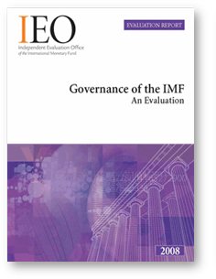
Supporting Executive Board oversight
IEO reports to the Board not management
Provides the Board with:
Effective instrument for traction
Institutional memory and perspectives
Channel for alternative viewpoints
Is there scope to do more?
More timely evaluations?
More IEO interaction with Board on follow-up?
Notes:
Another way in which the IEO contributes is by supporting Executive Board oversight over the institution.
Note that the IEO is the only component of IMF governance structure reporting to the Board. Fully independent of management—unlike OIA, ORM. Arms-length relationship Board –independence in terms of topic selection, content, hiring—but must also be close because IEO’s influence depends in large part on board back-up.
How does the IEO support executive Board oversight?
It provides an effective instrument for traction: MIP based on Board discussion and has to be approved by Board (unlike OIA audit MIPs) and has regular follow up in PMR, which again must be reviewed by the Board.
It supports institutional memory: Board tenure less than two years and declining; typically, Executive offices are fully involved with immediate operational issues, particularly offices covering a large number of countries using Fund resources.
Alternative viewpoints: the IEO can provide a channel to reflect concerns and views of members outside G20—fragile states, small states, role of capital account restrictions.
Scope to do more?
ED continuing interest in more timely evaluation, led to introduction of shorter evaluations. Very strong support for the early evaluation of IMF pandemic response. But is there scope to absorb more than two evaluations each year?
Also scope for more IEO interactions on issues related to follow-up on past evaluations, for example to comment on how staff Board papers prepared as part of implementation plans respond to issues raised in the original evaluation.

Slide 8
Supporting institutional integrity
The IEO provides a safeguard for institutional integrity through its examination of IMF analytical, research, and decision-making.
Some past evaluations have found evidence of undue political interference in difficult program situations, for example in the 2016 evaluation covering the 2010 Greek program
More generally, evaluations have confirmed high technical standards in IMF analysis and assessments. Some major misjudgments due to group-think, not interference
Is there scope to do more?
Notes:
Another current question is how the IEO supports institutional integrity. It has to be recognized that the Fund is inevitably a political institution deploying public resources responding to its members’ needs, its legitimacy credibility and ultimately effectiveness depend on ensuring that its technical work is based on the highest standards of impartiality and institutional excellence without political interference.
IEO has provided a safeguard for integrity though its analysis of IMF analytical and research work and the Fund’s decision-making processes
Some past evaluations have found evidence of undue political interference in difficult program situations, for example in the 2016 evaluation of the Greek program and the 2004 Argentina evaluation, and the 2003 capital account crisis evaluation.
More generally, however, evaluations have confirmed high technical standards in IMF analysis and serious efforts at being evenhanded—although questions have remained where judgements are needed. For example, over the past decade evaluations of IMF forecasting, IMF research, IMF advice on capital flow not raise concerns about political interference in technical work. Major mis-judgements often down to groupthink—shared by management, staff and shareholders, for example insufficient attention to financial vulnerabilities in the run-up to the global financial crisis.
Is there scope to do more to safeguard institutional integrity?
-- IEO often does not look at difficult cases for many years, eg Argentina 2018 program, due to limited resources and limits on evaluations of ongoing operational activities.
-- can be tension between learning and accountability functions. What is the right balance? Political challenges to integrity often difficult to conclusively prove and hard to find an appropriate remedy as shown by experience with the euro-area crisis evaluation, where a recommendation to take steps to reduce political interference with technical work did not have much concrete impact.
--

Slide 9
Setting the IEO work agenda
“The Director of IEO will be responsible for the preparation of the work program. The content should focus on issues of importance to the Fund’s membership and of relevance to the Fund’s mandate. It should take into account current institutional priorities.” (IEO Terms of Reference)
In practice:
Careful consultation to ensure focus on issues of current concern
Suitable timing is a difficult challenge, including to avoid “interfering with operational activities”
New products have allowed more nimble responses
Is there more scope to ensure timely and relevant evaluation?
Notes:
With scope for limited number of topics, topic selection must be strategic and geared to ensuring relevance and impact. In line with the TOR, the IEO director is responsible for setting the work program—focusing on issues of importance to the membership and relevant to the mandate. The program should also take into account current institutional priorities but at the same time avoid interfering with operational activities, which has raised some tensions.
In practice, the IEO is careful to consult broadly with the main stakeholders to identify issues of current concern. The Board discusses a menu of options in an informal seminar. Management staff and outside stakeholders are also consulted. The topic chosen is usually one in which the Board has strong interest and where IEO input provides timely input into staff’s own policy review work—ideally evaluations should come ahead of and feed into a staff review; little point in an evaluation of an area where Staff management and Board are in the midst of a review or where the policy framework has just been changed. The Board, staff and stakeholders are also consulted in preparing a detailed issues paper to make sure the focus of the evaluation is well set, reflecting the broad range of concerns.
Timing is a particular challenge in choosing topics – since many important and relevant policy issues have only just been changed or are being actively reviewed.
New shorter evaluations should in principle be helpful to allow more nimble responses. First pilot shorter evaluation on Ban-Fund collaboration on climate and other macrostructural issues was successful In delivering a well-regarded assessment, not hampered unduly by its narrower focus —although completion was delayed by the pandemic.
Finally I would also mention that IEO like other evaluations has increasingly focused on institutional learning as opposed to accountability. Focus of evaluation is helping institution find ways to be more effective in the future not holding individual accountable for past shortcomings. Emphasis on institutional learning also helps to encourage staff buy-in and absorption of the evaluation results.
Can we do more to ensure timely and relevant evaluations?
-- Possible to focus more on shorter more quickly completed evaluations. But this approach could put heavy pressures on the Fund’s absorptive capacity, a particular concern given current intense work pressures. Syaff have insisted that the IEO not comlete more than two evlautions for Board discussion and follow up each year.
-- Another change would be to reconsider the clause in the IEO TOR which requires the IEO to avoid interfering with operational activities, including current programs. The interference clause was deliberately left somewhat ambiguous and allowed for issues to be settled in a case by case manner. In practice the interference clause has usually not been an issue, especially for surveillance and capacity development work. But it has been a factor in setting the timing and scope of a number of evaluations over the years. Most often in the context of evaluations of country programs, where there has been concern that evaluation could potentially interfere with negotiations on a current or future program.
However, while appreciating these concerns, application of the interference clause can lead to delays and curtail the IEO’s capacity to address issues related to current institutional priorities.. This issue has been discussed in successive external evaluations, but no consensus achieved at the Board on more precise language.

Slide 10
Some issues for discussion
Over-arching question: how can the IEO increase its overall impact ?
Should IEO be more involved in the follow-up to its reports?
Should IEO shift product mix further toward more focused, more timely evaluations on issues of current concern?
Should IEO pay more attention to integrity issues?
Should IEO work more intensively with counterparts in partner institutions?
Notes:
This page highlights four key issues for discussion. I’d be interested to hear your views.
Over-arching question: how can the IEO increase its overall impact based on strengthening its three core functions, supporting Board oversight, supporting institutional learning and strengthening external credibility.
I have put some specific proposals on the table.
First, for the IEO to be more involved in the follow-up process to its evaluations, working more closely with staff and the Board.
Second, to shift the product mix towards more more timely issues of current concern, possibly including some reconsideration of the non–interference clause.
Third to put more resources into strengthening outreach using new virtual communication and social media more effectively.
Fourth paying more attention to integrity issues.
In each case I think there are both pros and cons that need to be carefully considered. The issue is often getting the right balance between different objectives and effective deployment of limited resources, in the IEO but also in the Fund. Hopefully the IEO@20 initiative can contribute. These are also issues where the next external evaluation in 2024 can make an assessment.

Slide 11
Thank you!
Visit us at www.ieo-imf.org

