Slide 1
The IMF’s Emergency Response to the COVID-19 Pandemic
Prakash Loungani, Assistant Director
Independent Evaluation Office
IEO Seminar| March 21, 2023

Slide 2
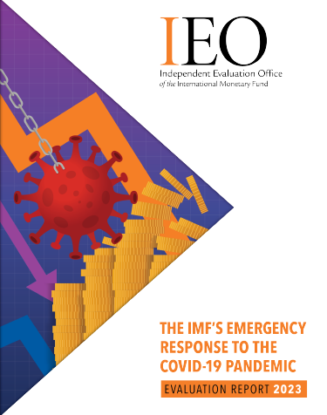
ERP: Why an early evaluation?
  Look for timely lessons on how well the Fund adapted its:
    Lending framework
    Processes for formulating the economic outlook and policy advice
    Internal HR and budgetary practices
  Contribute to discussion on how to strengthen IMF readiness to deal with future global crises?

Slide 3
Scope of evaluation
  Evaluation covers Feb. 2020 to April 2021 and addresses four topics:
    Overall strategy
    effectiveness of emergency financing (EF)
    reformulation of outlook and policy advice
    HR and budget response to crisis-related needs
  Evaluation does not evaluate full range of Fund surveillance and capacity development activities or consider longer term implications of some key decisions and actions

Slide 4
Overall strategy
Typically, IMF financial support comes with strings attached (the so-called upper-credit tranche or UCT conditionality)
  High-access financing disbursed in tranches
  Full-fledged program with macroeconomic and structural conditionality
  In this crisis, IMF financial support came mainly through emergency financing with augmented access and limited conditionality
  Financing disbursed upfront
  Ex ante pre-qualification criteria
This approach allowed very quick disbursement to many countries

Slide 5
Fund provided emergency financing quickly
  Fund used Rapid Financing Instrument (RFI) and Rapid Concessional Facility (RCF) to disburse funds quickly without the usual level of conditionality: fast action; but amount relatively modest?

Slide 6
Concerns about the Fund’s emergency financing response
  Did Fund provide too much financing on too easy terms?
    Risks to Fund’s balance sheet?
    Crowding out of standard programs?
    Adequacy of governance safeguards?
    ►Did IMF become an aid agency? (Ken Rogoff)
  Did Fund do enough? Was response tailored response to scale of crisis and country needs?
    Financing relative to needs?
    Countries that did not receive emergency financing?
    Evenhandedness of access and use of governance safeguards?
    Coordination with World Bank?
    Catalytic effect on official and private flows?

Slide 7
Emergency financing: balance sheet risks
  Many borrowers in debt distress or at high risk; many ‘red-zone’ cases
  Debt Sustainability for Emergency Financing Borrowers
  (number)
  Were the heightened risks sufficiently analyzed up front?
  What will be longer term consequences of higher indebtedness for countries and the Fund?

Slide 8
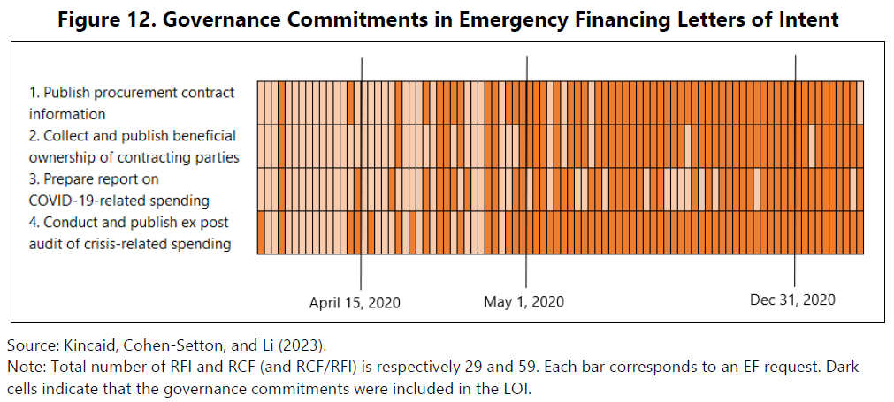
Governance safeguards: a moving target
  Fund staff scaled up attention to governance safeguards over time

Slide 9
EF access: concerns about lack of tailoring to BOP need
  Fund financing covered 25-30 percent of expected BOP gap.
  Small developing states (SDS) were expected to rely on reserve drawdowns
Source: RCF-RFI requests; IEO calculations.

Slide 10
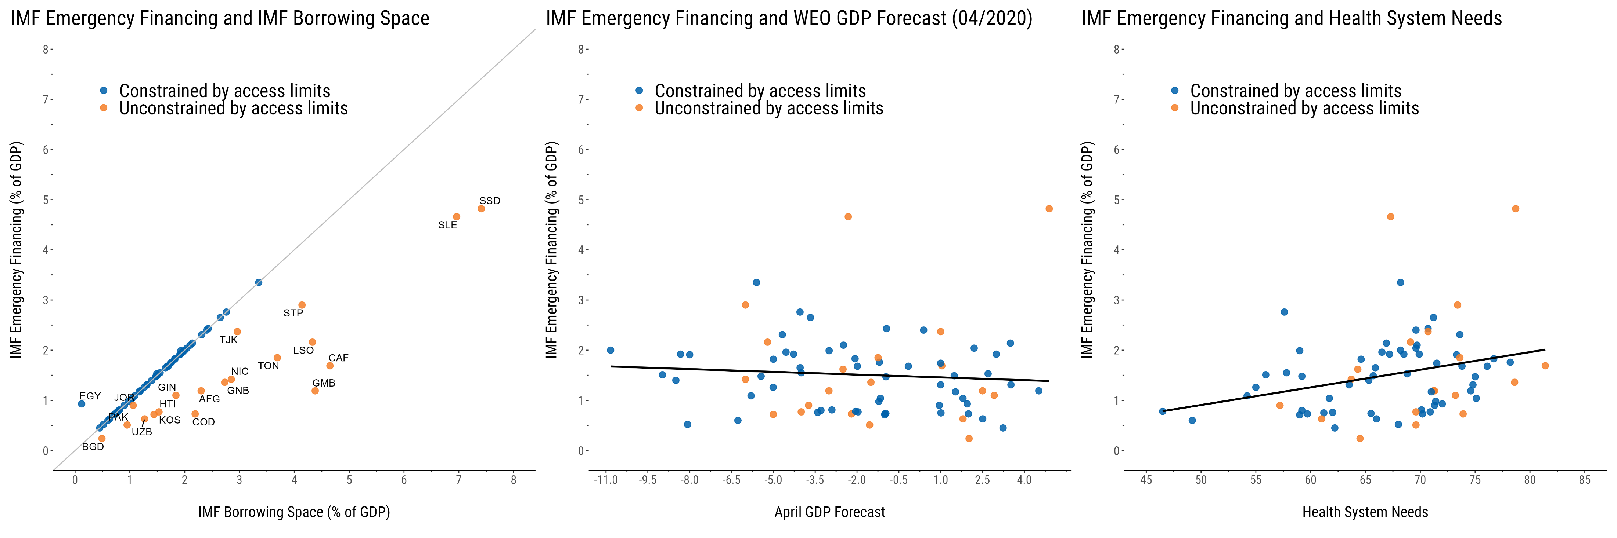
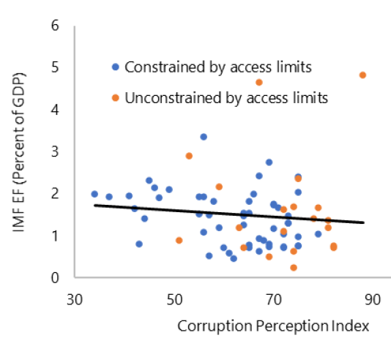
Drivers of access to emergency financing
  Access limited by available borrowing space and not closely correlated with expected economic stress or perceived corruption levels
Source: FIN, WEO, Transparency International; IEO calculations. Note: IMF borrowing space is the maximum amount of emergency financing that a country can access given access limits at the time of approval on emergency financing, GRA, and PRGT resources. The grey line indicates the 45-degree line. The black lines show bivariate regression lines. The figures show data up to end of May 2021.

Slide 11
Emergency financing: reasons for no access
  In a few cases, access was held back or curtailed, raising evenhandedness concerns
  Country examples
    Policy/governance concerns: (e.g., Belarus, Iran, Nicaragua)
    Debt concerns (e.g., San Marino, Zambia, Zimbabwe)
Source: Staff interviews; IEO calculations.

Slide 12
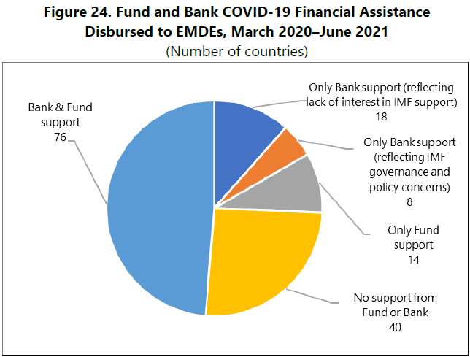
Fund and Bank COVID-19 financing
    Fund and Bank generally aligned, but notable differences in a few cases raise concerns about coherence of strategic approach
  The Fund relied on EF, the Bank more on standard policy-based instruments.
  Several countries received Fund support, but Bank held back disbursements for policy concerns (e.g., Nigeria, South Africa)
  Also, several cases where the Bank but not the Fund provided financial support.

Slide 13
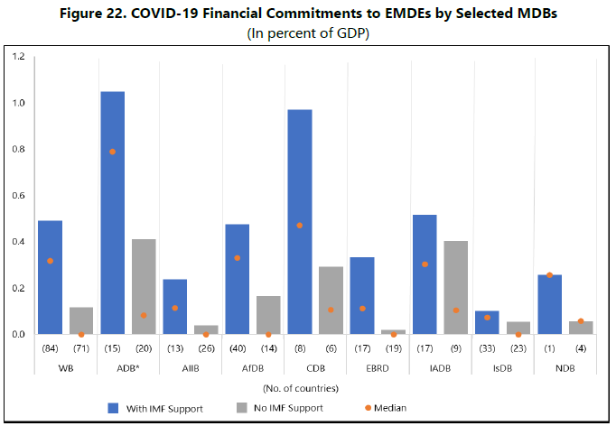
EF access: catalytic effect on official sources
  Countries with access to Fund emergency financing also received more financial support from other international financial institutions

Slide 14
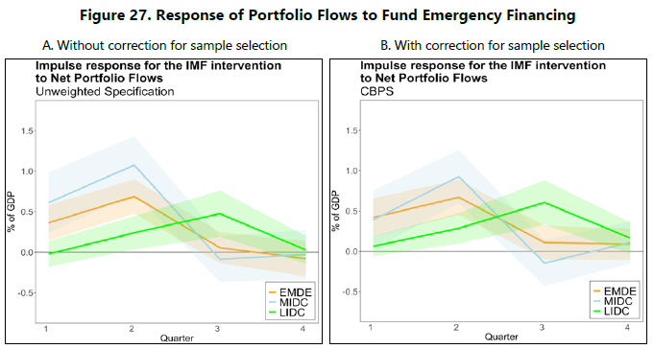
EF access: catalytic effect on portfolio flows
  Countries with access to Fund emergency financing experienced higher net portfolio inflows

Slide 15
Outlook and policy advice
IMF cut growth forecasts for 2020 sharply in April and June 2020
    Fears that IMF growth forecasts would be too rosy proved misplaced
Forecasts for 2020 inflation proved accurate, but not 2021 forecasts
    2021 upsurge in inflation was missed despite some early warnings (Summers; Blanchard)
Fiscal policy
  “Spend, spend, spend, but keep the receipts”
  Caution against premature withdrawal of fiscal support
      Recognition of scale of shock; desire to avoid past mistakes.
Monetary policy
  Support for easing policy interest rates
  Not much public comment on use of UMP by EMs

Slide 16
HR and budget response to crisis-related needs
  Multiple initiatives put in place to address crisis-related staffing needs.
    Increase in full-time equivalent headcount to frontline departments
    Other steps (e.g., better resource-sharing; rehiring of recent retirees)
  Additional spending to meet crisis needs accommodated within existing budget envelope, with flexibility from carryover and savings from reduced travel

Slide 17
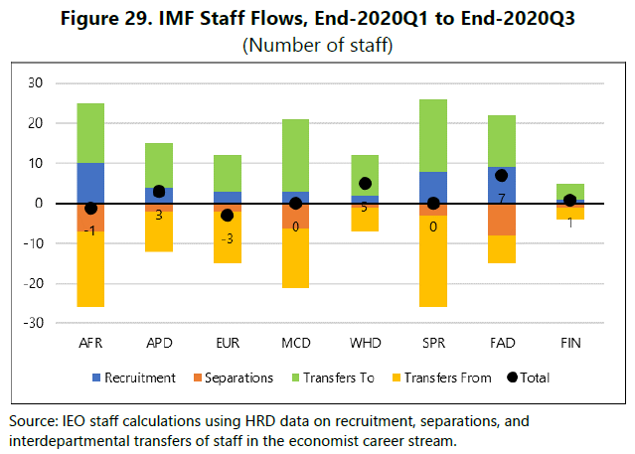
Staff inflows and outflows during the pandemic
  With an internal market-driven process still in operation during the pandemic, departments in need experienced large outflows of staff, leading to limited net gains.

Slide 18
Recommendations
Recommendation 1. Develop a toolkit of special policies and procedures that could be quickly activated to help address the particular needs and circumstances of a global crisis
  Participatory consultation with the full Board at an early stage of a global crisis
  Activation of temporary modifications to the lending framework
    higher access limits
    temporary “global crisis-response window”
    crisis-only precautionary facility
    streamlined review procedures
    temporary modification of surcharge policy
Recommendation 2. Take steps to reinforce institutional preparedness to deal with global crises and other large shocks
  Review of emergency financing policy and practice (to allow for greater tailoring of access to needs and capacity to repay)
  Further development of the toolkit of precautionary instruments (to make it more attractive to a wider range of countries)
  Support country efforts to strengthen governance measures
  Foster a more coherent approach to strategic partnerships with the World Bank and other official institutions (e.g., launch a “financing tracker”)
  Table-top exercises and a crisis playbook

Slide 19
Broad Management and Executive Board Support for Findings and Recommendations
  The IMF Managing Director:
    welcomed overall finding that Fund rose to the occasion despite extraordinary challenges and risks
    agreed with evaluation’s overarching message that Fund needs to be prepared better for potential future global crises
    supported the two main recommendations, while emphasizing that overly prescriptive or rigid processes should be avoided
  Executive Directors:
    Most Directors expressed either broad or qualified support for Recommendation 1 on developing special policies and procedures that could be quickly activated.
    Most Directors broadly supported Recommendation 2 on taking steps to reinforce the IMF’s institutional preparedness to deal with global crises and other large shocks
    Directors agreed that crisis responses should not be pre-determined and emphasized need to consider longer-term implications
Notes:
Report was discussed at the Executive Board in January.
At the meeting MD welcome the evaluation, appreciating recognition that progress has been made but also accepting the assessment that there is much room to improve quality and impact.
The Board also welcomed the evaluation and broadly supported all the recommendations while having some differences of views among them about how they would be best implemented.
Particular areas for discussion included the prioritization of the FSAP across countries, the value of IMF conducted stress tests, and the extent to which the EWE should be disseminated.
There was consensus that financial surveillance needed more resources but that these needed to be found within the fund’s budgetary envelope which is already quite stretched.

Slide 20
Next Steps
  Management Implementation Plan due within 6 months
  Key findings and recommendations to feed into
    Review of access limits for emergency financing
    Review of Precautionary Facilities
    Review of the Implementation of the 2018 Framework for Enhanced Fund Engagement on Governance
Notes:
Now responsibility of managemental and staff to implement Board endorsed recommendations. They are required to prepare an implementation plan for Board approval within six months. But already key findings are feeding into a number of important workstreams; the comprehensive surveillance review and the FSAP review to be completed next year; the continuing budget discussions, and the new HR strategy.

Slide 21

ThankS From THE TEAm To:
Fund Staff , Authorities, and experts for candid interviews and comments
Staff at other evaluation offices, particularly world bank IEG
IEO ADMIN TEAM and our EDITOR:
Elena Pinillos, arun bhatnagAR, NICOLE TUMBACO, AMY GAMULO, JUDY BURNS

