Slide 1
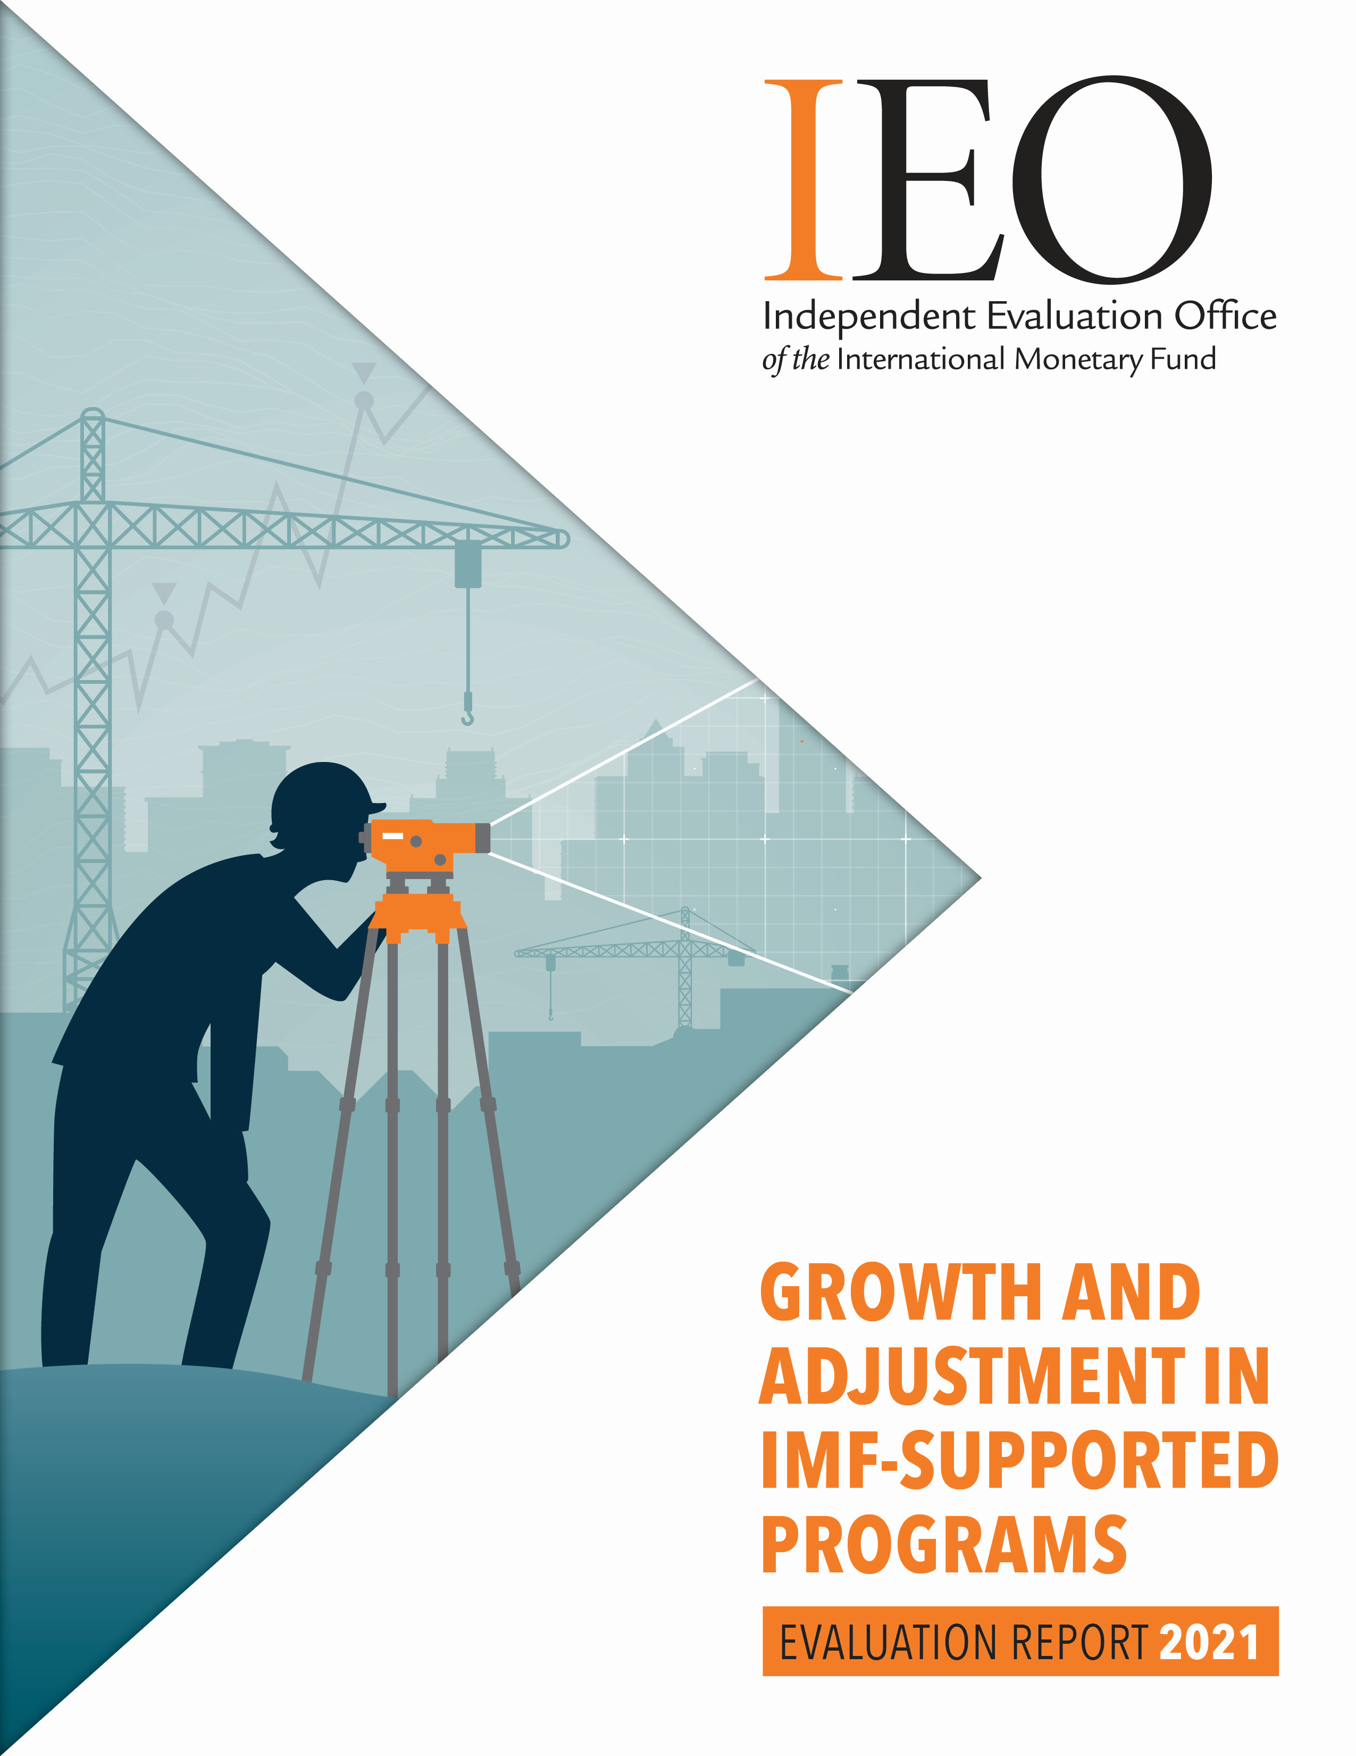
Growth and Adjustment in
IMF-Supported
Programs: An IEO Evaluation
Charles Collyns and Jun Kim
Center for Global Development, September 28, 2021

Slide 2
Purpose and Motivation
Purpose
        Assess how well IMF-supported programs have helped to support economic growth while delivering necessary adjustment for external viability.
        Draw lessons on the Fund’s lending and conditionality framework and make recommendations.
        Motivation
        IMF Articles of Agreement: “…make resources temporarily available to members to help correct BOP problems without resorting to measures destructive of national or international prosperity.”
        Seemingly lackluster growth outcomes under IMF programs often criticized as indicative of an excessive austerity bias and resulted in stigma, discouraging use of Fund resources and challenging Fund reputation.
        Staff guidance and views on program conditionality focused on stabilization objectives and parsimony of conditionality with less attention to growth

Slide 3
Evaluation Sample and Outputs
Program coverage
        IMF financing arrangements with conditionality, approved and completed between September 2008 and March 2020.
        Programs after the outbreak of the COVID-19 pandemic not covered.
        Background studies
        Recommendations are based on key findings and lessons from thematic studies and country case studies
        6 thematic studies: (1) cross-country analysis of program design and growth outcomes; (2) initiating growth surges: the role of IMF-supported programs; (3) fiscal adjustment and growth; (4) structural conditions, structural reforms and growth; (5) exchange rate adjustment and growth; (6) market debt operations and growth
        17 country case studies across five regions (Africa, Asia and Pacific, Europe, Middle East and Central Asia, and Western Hemisphere)

Slide 4
Structure of Presentation
Key findings
  Attention to Growth in IMF-supported Programs
  Growth Optimism and Macro Framework
  Fiscal Policy
  Structural Conditions and Structural Reforms
  Exchange Rate Policy
  Market Debt Operations
General lessons from country case studies
Recommendations
Reactions and follow-up

Slide 5
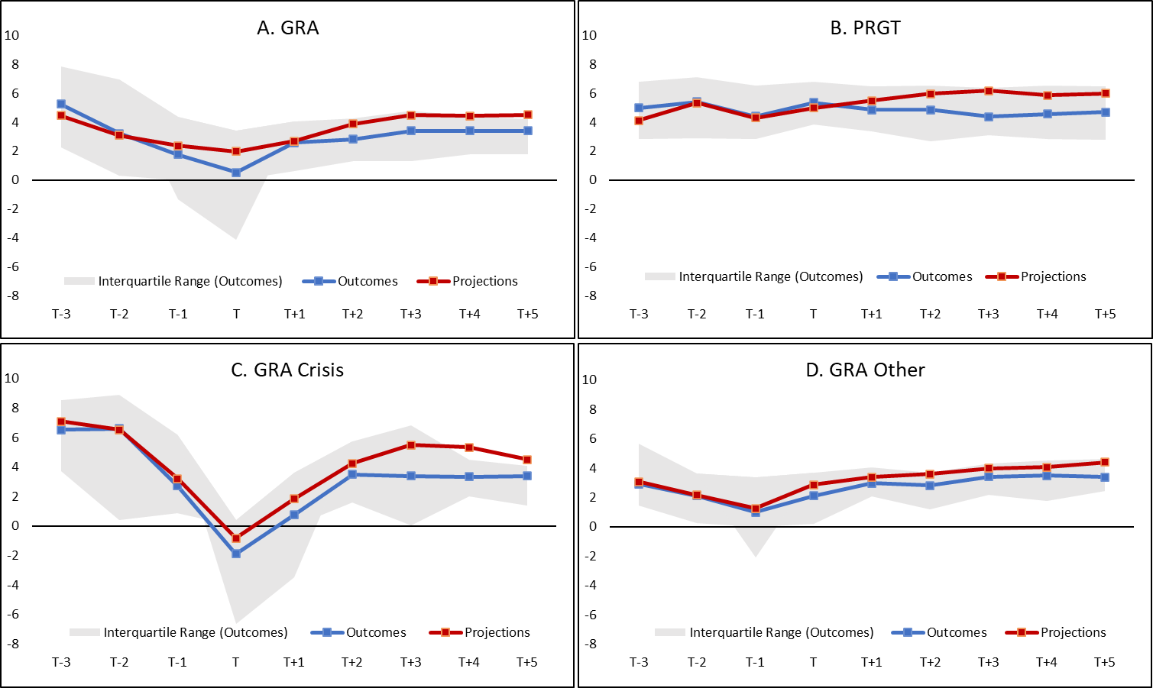
Increasing Attention to Growth in IMF-supported Programs
Growth Trajectories
(Cross-country medians; in percent; T = first year of program)
  The IMF’s increasing attention to supporting activity during a program and fostering medium-term growth seems to have delivered some positive results.
  GRA: Growth outcomes showed U-shaped trajectory with the trough in the first year (T) of the program followed by a recovery.
    Negative growth in year T in 40 percent of GRA programs—2/3 of which were crisis GRAs arranged in response to GFC/EA debt crisis.
    Much steadier growth outcomes in other GRAs
  PRGT: Less marked pattern in the growth trajectory with initial modest recovery in year T followed by a steady decline in growth before leveling off.
Source: Kim and others (2021).

Slide 6
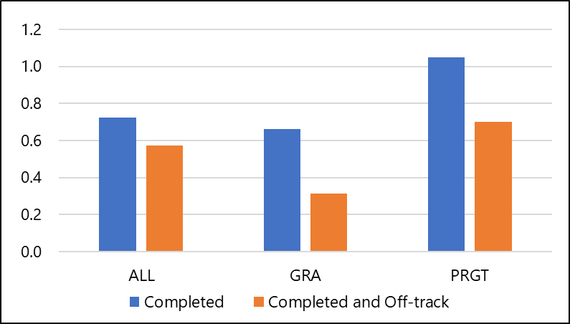
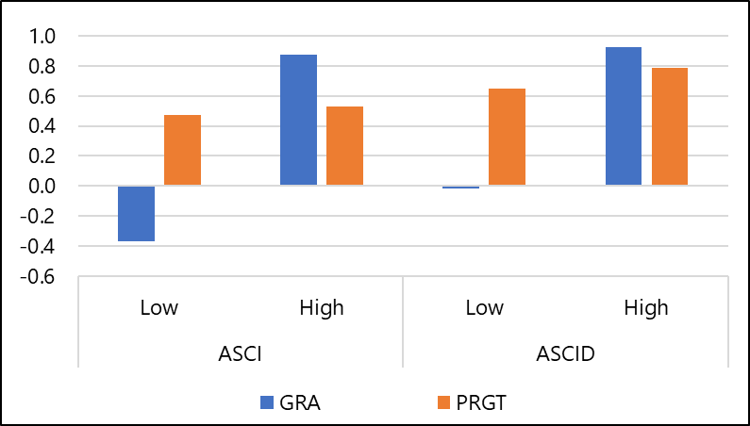
Increasing Attention to Growth in IMF-supported Programs
Short Run Growth Impact of IMF-Supported Programs
(Relative to a counterfactual of no Fund engagement; In ppts)
  The evaluation does not find evidence of a consistent bias towards excessive austerity in
  IMF-supported programs during the evaluation period.
  Cross-country evidence suggests that both GRA and PRGT programs have yielded growth benefits relative to a counterfactual of no Fund engagement
  Larger benefits for completed programs with stronger implementation and higher depth of structural conditions
A. Overall Impact
B. Impact by Implementation and Depth of Structural Conditions
Source: Kim and others (2021).
Note: ASCI = average SC implementation score; ASCID =average composite score of SC implementation and depth.

Slide 7
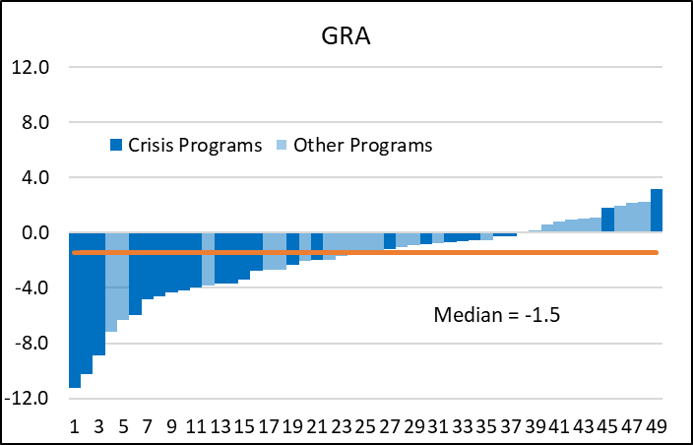
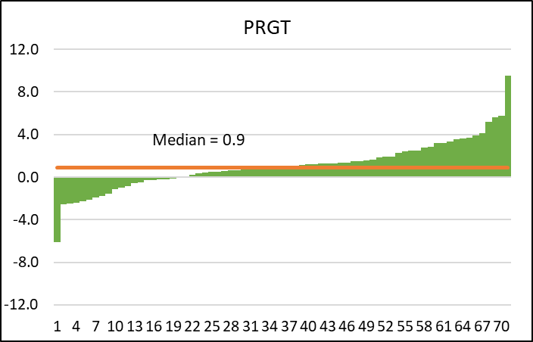
Increasing Attention to Growth in IMF-supported Programs
Growth Outcomes Relative to Benchmark
(In percent)
  Except in the crisis context, IMF-supported programs were in most cases able to sustain output broadly in line with historical norms* while delivering needed adjustment.
    Historical norms explained by country specific trend and external factors only
  Historical data over a longer time horizon suggest a positive role of IMF-supported programs at initiating sustained growth surges, more so in the 2000s than in the previous decades.
Source: Kim and others (2021).

Slide 8
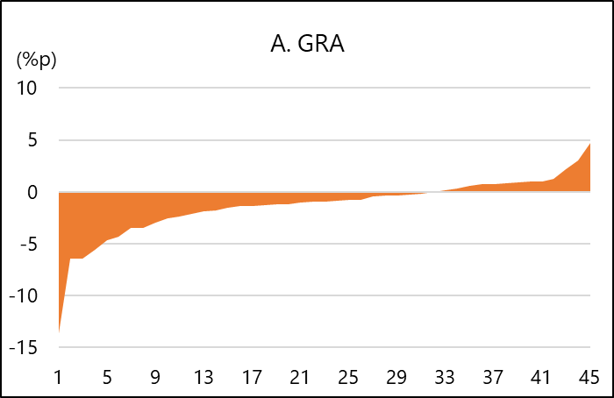
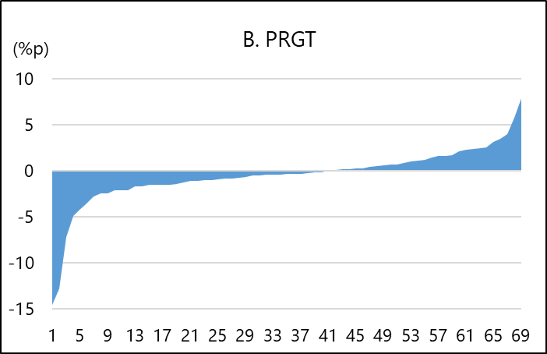
Growth Optimism and Macro Framework
Distribution of Growth Outcomes Relative to Initial Projection
(In percentage points)
  Program growth outcomes consistently fell short of program projections, more so in GRA than in PRGT programs.
  One half of the programs experienced a growth shortfall of ½ ppts or more, while one fourth had a growth shortfall of over 1½ ppts
  Less realistic fiscal multiplier assumptions seem to have been a source of growth optimism, especially in GRA programs outside of a crisis context.
  Case studies suggest that:
    Political economy factors in program negotiations played a significant role in motivating ambitious growth projections.
    Limited attention was paid in the program design stage to contingencies to respond to possible growth shortfalls.
Sources: WEO database; IEO staff calculations.
Note: Data represent growth deviations (actual minus projection) in percentage points.

Slide 9
Fiscal policies typically incorporated growth-friendly measures, but with mixed success.
  Tax mobilization improved in PRGT programs while the post-program tax structure became more growth-friendly in GRA programs.
  GRA programs relied heavily on spending cuts to achieve adjustment, and efforts to protect low-income and vulnerable groups often fell short of their goals.
  Health and education spending did not increase significantly in either PRGT or GRA programs.
  Growth benefits of higher public investment were limited by poor project selection and wasteful implementation, especially in PRGT programs.
  To help address such concerns, more attention is needed to building better public financial management and governance as well as monitoring and reporting on the social and distributional impact.

Slide 10
Structural conditionality generally played a positive role in promoting reforms and growth, but the potential growth benefits of structural reforms were not fully realized.
Composition of Structural Conditions by Depth and Sector
(At program approval)
  Implementation of structural conditions (SCs) helped to boost growth during and after programs, with a stronger growth impact for SCs with higher depth and growth orientation.
  But the bulk of SCs was oriented to stabilization and of relatively low depth and growth-orientation
  CD assistance has not been consistently effective in strengthening SC implementation, which was significantly weaker in areas outside Fund expertise and where collaboration with partners was sought.
  These findings suggest the need to increase the focus on deeper, more growth-supporting reforms, supported by closer integration of program and CD work and stronger collaboration with partners.
Source: Kim and Lee (2021).

Slide 11
The use of the exchange rate as a policy tool was quite limited
  FX regime transition in the program context was infrequent and more often toward greater fixity than flexibility, and PRGT programs relying on the exchange rate anchor tended to lose competitiveness.
  Efforts were typically made to correct significant pre-program overvaluation,.
  Significant REER depreciation, where it occurred, supported external adjustment and growth, particularly in PRGT programs.
  This experience suggests:
    Greater scope to use the exchange rate as a policy tool while respecting the country’s regime choice and avoiding exchange rate manipulation.
    The need for early attention to providing a supporting policy framework, including by developing a deep FX market and establishing a credible inflation anchor.

Slide 12
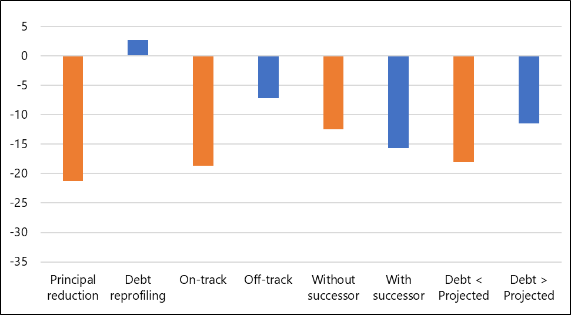
Market debt operations were sometimes too little, too late
Debt Outcomes of Programs with Debt Operations
(3-year cumulative change in debt from program approval)
(In percent of GDP)
  Debt operations (DOs) with principal haircuts and upfront fiscal adjustment were more successful than debt reprofiling/coupon reduction in renewing market access and restoring growth.
  However, DOs were sometimes insufficiently deep and delayed.
  This experience suggests that, while respecting the neutrality principle, the IMF should seek to ensure ambitious debt operations upfront, based on careful application of the DSA frameworks.
Source: Erce (2021).
Note: Based on the data for 10 programs with market debt operations. “Without successor” stands for programs not followed by a successor program in less than 3 years; “Debt < projected” denotes programs where actual debt is less than projected.

Slide 13
General Lessons from Country Case Studies
  There is no simple recipe for delivering better growth outcomes in IMF-supported programs.
  However, it is important for all programs to ensure that the adjustment and growth strategy is fully owned by the government and broadly supported.
  The groundwork for a successful policy response should ideally be laid well in advance through surveillance and CD work.
  Meaningful reforms to strengthen growth resilience take many years to put in place and become effective, even with strong efforts to provide CD support.
  Growth and reform strategies should pay adequate attention to social and distributional consequences.
  Fair distribution of the burden of adjustment and the rewards of recovery are of prime importance to meet national goals and to ensure continued public support for program implementation.

Slide 14
Recommendation 1—Attention to growth implications of IMF-supported programs should become more thorough, systematic, realistic and sensitive to social and distributional consequences.
  Board papers supporting GRA and PRGT programs should clearly analyze the program’s growth implications and discuss the country’s growth strategy.
  Program documents should provide more systematic coverage of the distributional consequences of adjustment and reform policies during the program and over time.
  Particular attention should be paid to discussion of fiscal multiplier assumptions.
  Program design should pay more consistent attention to contingencies for growth shortfalls, based on scenario analysis.
  Consider revisions to the Conditionality Guidelines and the Operational Guidance Note on Conditionality

Slide 15
Recommendation 2—IMF-supported programs should pay greater attention to supporting deep, more growth-oriented structural reforms.
  The structural reform strategy should be geared to what is important and not what is most easy to agree on or monitor or where the IMF has core expertise,
  Structural conditionality should be parsimonious but also more focused on correcting underlying distortions and removing structural impediments
  The Fund should seek to strengthen collaboration with the WB and other relevant partners in design and implementation of structural reforms in shared/non-core areas.
  The Fund should revisit how CD support is integrated with program design and implementation aimed at promoting deeper and more successful reform efforts.

Slide 16
Recommendation 3—The Fund should continue to invest in building a toolkit of models and monitors for analysis of the adjustment-growth relationship.
  The Fund should develop a suite of models that are tractable, easily accessible by country desks, and suitable for analyzing the adjustment-growth relationship in the program context.
  Country teams should apply the models to produce more realistic projections and better explain baseline projections and associated risks to authorities.
  Further attention should be given to developing and deploying monitors to help track program impact on key distributional indicators, in close collaboration with the World Bank and other agencies.

Slide 17
Reactions and follow-up
  Broad support: Both the Managing Director and the Board welcomed the evaluation and broadly supported its findings and all recommendations at August 30 Board meeting.
  Timely: Evaluation was viewed as particularly timely and relevant as many member countries now seek Fund program support to recover from the pandemic.
  Qualifications: Directors supported the recommendation that attention to growth issues in Fund programs should be more thorough but at the same time:
    They reiterated that the Fund’s core objective was to help members’ resolve their balance of payments need.
    That Fund conditionality should be parsimonious and focused in core areas of expertise.
  Next steps: Implementation plan due by February 2022.

Slide 18









Thank you!
  Visit us at ieo.imf.org
  The ADG team would like to thank:
  Peter Allum, Ajai Chopra, Aitor Erce, Sanjeev Gupta, Russell Kincaid, Mauro Mecagni and Marco Pinon-Farah for background papers;
  Esha Ray and Roxana Pedraglio for editorial assistance;
  Annette Canizares, Arun Bhatnagar and Nicole Tumbaco for administrative assistance.
  And also:
  IMF staff who gave their time generously to answer our many questions;
  the numerous people outside the Fund we interviewed;
  and the participants in our internal workshops who read and commented on drafts.

