Slide 1

Geoeconomic Fragmentation and Industrial Policy
Presented by Daria Zakharova
Deputy Director
Strategy, Policy, and Review Department
International Monetary Fund
March 2024
The views expressed herein are those of the author and should not be attributed to the IMF, its Executive Board, or its management.
Photo: Chris Martin/Newscom

Slide 2
Economic integration slowing, restrictions on the rise
Global Flows of Goods, Services and Finance
($ trillion, unless indicated otherwise)
Trade Restrictions Imposed
(number)
Sources: IMF Balance of Payments, World Bank and IMF staff calculations.
Note: “Finance” refers to global net liabilities of direct investment, portfolio flows, and other investments. Projection for 2023 is estimate based on publicly available projections for growth of trade and GDP in October version of 2023 World Economic Outlook.
Sources: Global Trade Alert, updated as of February 23, 2024.

Slide 3

Overview of Fund’s SDN work on GEF
Geo-economic Fragmentation (GEF): A policy-driven reversal of global economic integration, often guided by strategic considerations (e.g., national security, economic security, strategic autonomy). It does not include reversals due to autonomous changes (e.g., shifts in technology / preferences), or policies motivated primarily by prudential concerns (e.g., macro-prudential measures).
GEF will affect the global economy through interrelated channels
  Incl. trade, migration, capital flows, technology, uncertainty, and provision of global public goods
GEF costs can be significant.
  Severe decoupling in trade and technology could lead to losses of 8-12 percent in some EMDEs
Averting runaway GEF requires a deliberate approach to international cooperation.
  Pillar I: Multilateral cooperation in areas of common interest
  Pillar II: Open plurilateral initiatives if multilateral not possible
  Pillar II: “Guardrails” to mitigate global spillovers and protect the vulnerable

Slide 4
The role of the Fund in mitigating fragmentation
Multilateral engagement (Pillar I) — | Plurilateral engagement (open and non-discriminatory) (Pillar II)— | Guardrails on unilateral actions (Pillar III) —
Surveillance/analytics -- to inform the international community about the international impact of unilateral actions. The convening role -- to bring together countries to discuss issues of common interest and develop common approaches. | Surveillance/analytics and CD -- best practices, guidance on modalities and safeguards; CD, if needed. The convening role -- to help build bridges across open and non-discriminatory plurilateral initiatives. | Surveillance/analytics and CD -- to help inform the design of guardrails; policy advice to members and CD, if needed. The convening role -- to improve information on unilateral actions and on their cross-border spillovers.
To be effective the Fund should be
Representative of its global membership
Evenhanded and impartial in its operations and policy advice
Adequately resourced for a more shock-prone global environment

Slide 5

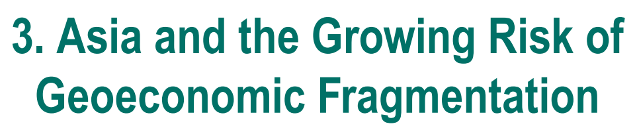
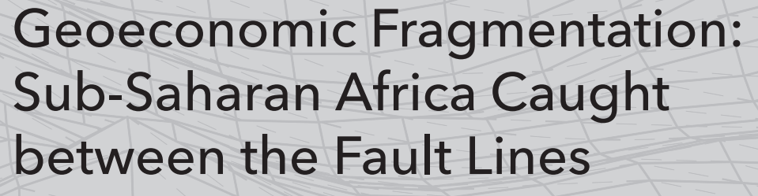


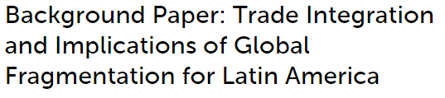
Overview of Fund’s surveillance work on GEF
Flagships
October 2023 WEO on commodity markets
REOs
Bilateral surveillance
Many AIVs, incl.
April 2023 AFR REO
October 2023 WHD REO
April 2023 GFSR on financial fragmentation
April 2023 WEO on FDI fragmentation
Australia (2024)
China (2024)
Cambodia (2024)
India (2023)
Korea (2023)
Latvia (2023)
Singapore (2023)
Thailand (2024)
October 2022 APD REO

Slide 6
Industrial policy is back
Working definition of IP: Any targeted government intervention aimed at developing or supporting specific domestic firms, industries, or economic activities to achieve national economic or non-economic (such as security, social, or environmental) objectives.
→ See also: Industrial Policy: Trade Policy and World Trade Organization Considerations in IMF Surveillance
Number of New Restrictive Trade Measures
New Industrial Policy Measures
(cumulative, based on announcements since Jan 2023; sample of 70 countries)
Source: Evenett, Jakubik, Martin and Ruta (2024)

Slide 7
IP objectives and targeted sectors
Objectives: increasing focus on climate, supply chain resilience and national security
Target sectors: dual-use technologies, high-tech products (e.g., semiconductors) and their inputs; share of measures targeting medical goods declined
New Industrial Policies by Sector
New Industrial Policies by Stated Objective
Source: Evenett, Jakubik, Martin and Ruta (2024)
Source: Evenett, Jakubik, Martin and Ruta (2024)

Slide 8
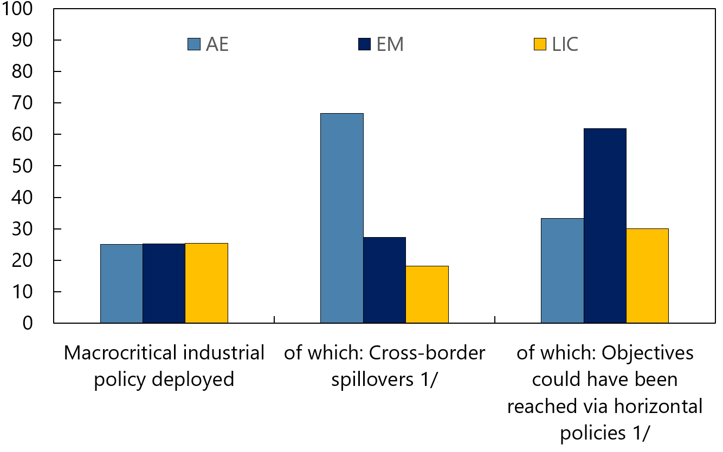
Staff Survey (August 2023) on IP spillovers
About a quarter of countries introduced macro-critical IPs since end-2021 (48 countries)
More than 2/3 of macro-critical IPs in AEs are assessed as potentially triggering cross-border spillovers
AE objectives: climate and security considerations
EMDE objectives: growth, diversification and export performance
Staff Survey: Macro-criticality and Cross-border Spillovers
(percent of respondents)
Staff Survey: Macro-critical IPs, by Motive
(percent of responses)
1/ Answers are not available for all countries that deployed macro-critical IP

Slide 9
When to cover IP in bilateral surveillance
Macro-criticality. Staff are required to cover IP where such policies are assessed to significantly influence present or prospective balance of payments or domestic stability.
Significant cross-border spillovers. Staff should discuss spillover effects of a member’s economic and financial policies—including IP—that may have significant impact on other members or affect the effective operation of the International Monetary System.
National Security Considerations (Decision No. 144-(52/51)
Not expected to discuss appropriateness of IP driven solely by national security objectives, nor propose alternative policies to accomplish these objectives.
But required to discuss the economic implications
--- if IP is motivated by security objectives and deemed macro-critical or may generate significant cross-border spillovers.
--- if IP has intermediate economic objectives, staff should discuss the economic implications of policies adopted to reach such intermediate economic objectives.

Slide 10
Next steps
Future work will focus on:
    Addressing data/information gaps, in collaboration with other International Organizations, to track where and how GEF is manifesting
    Monitoring IP and trade policy measures (by objective, sector, instrument) to inform bilateral and multilateral surveillance
    Deepen analytical work on how countries can best adapt to GEF and design non-distortionary IPs
    Developing analytical tools (e.g., for identification of externalities, cost-benefit analysis of specific trade policy and IP measures)

Slide 11
Links
Confronting Fragmentation Where It Matters Most: Trade, Debt, and Climate Action (imf.org)
Geoeconomic Fragmentation and the Future of Multilateralism (imf.org)
Regional Economic Outlook for Asia and Pacific, October 2022 (imf.org)
World Economic Outlook, April 2023: A Rocky Recovery (imf.org)
Global Financial Stability Report, April 2023: Safeguarding Financial Stability amid High Inflation and Geopolitical Risks (imf.org)
Regional Economic Outlook for Sub-Saharan Africa, April 2023 (imf.org)
World Economic Outlook, October 2023: Navigating Global Divergences (imf.org)
Regional Economic Outlook: Western Hemisphere, October 2023 (imf.org)
Industrial Policy: Trade Policy and World Trade Organization Considerations in IMF Surveillance
Industrial Policy Coverage in IMF Surveillance— Broad Considerations
The Return of Industrial Policy in Data (imf.org)

